Slide 1
6
Bones and Skeletal Tissues: Part B

Slide 2
Bone Development
Ossification 骨化 (osteogenesis [生理]骨生成)
  Process of bone tissue formation
  Formation of bony skeleton
    Begins in 2nd month of development
  Postnatal bone growth
    Until early adulthood
  Bone remodeling and repair
    Lifelong
© 2013 Pearson Education, Inc.

Slide 3
Two Types of Ossification
Endochondral ossification
  Bone forms by replacing hyaline cartilage
  Bones called cartilage (endochondral) bones
  Forms most of skeleton
Intramembranous ossification
  Bone develops from fibrous membrane
  Bones called membrane bones
  Forms flat bones, e.g. clavicles and cranial bones
© 2013 Pearson Education, Inc.

Slide 4
Endochondral Ossification
Forms most all bones inferior to base of skull
  Except clavicles
Begins late in 2nd month of development
Uses hyaline cartilage models
Requires breakdown of hyaline cartilage prior to ossification
© 2013 Pearson Education, Inc.

Slide 5
Endochondral Ossification
Begins at primary ossification center in center of shaft
  Blood vessel infiltration of perichondrium converts it to periosteum → underlying cells change to osteoblasts
Bone collar forms around diaphysis of cartilage model
Central cartilage in diaphysis calcifies, then develops cavities
Periosteal bud invades cavities → formation of spongy bone
Diaphysis elongates & medullary cavity forms
Epiphyses ossify
© 2013 Pearson Education, Inc.

Slide 6
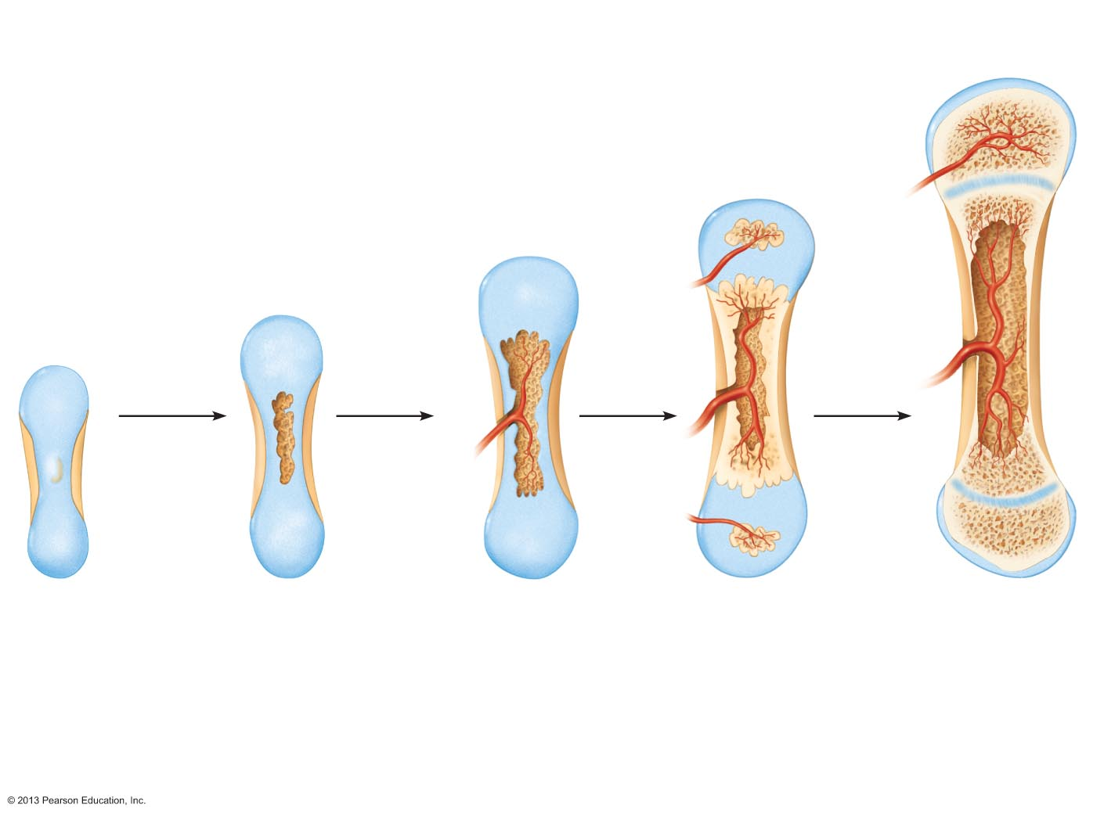
Figure 6.8 Endochondral ossification in a long bone.
Slide 1
Week 9
Month 3
Birth
Childhood to
adolescence
Articular
cartilage
Secondary
ossification
center
Spongy
bone
Area of
deteriorating
cartilage matrix
Epiphyseal
blood vessel
Epiphyseal
plate
cartilage
Hyaline
cartilage
Spongy
bone
formation
Medullary
cavity
Bone collar
Blood
vessel of
periosteal
bud
Primary
ossification
center
1
2
3
4
5
Bone collar
forms around the
diaphysis of the
hyaline cartilage
model.
Cartilage in the
center of the
diaphysis calcifies
and then develops
cavities.
The periosteal
bud invades the
internal cavities
and spongy bone
forms.
The diaphysis
elongates and a
medullary cavity
forms. Secondary
ossification
centers appear in
the epiphyses.
The epiphyses
ossify. When
completed, hyaline
cartilage remains
only in the
epiphyseal plates
and articular
cartilages.
© 2013 Pearson Education, Inc.

Slide 7
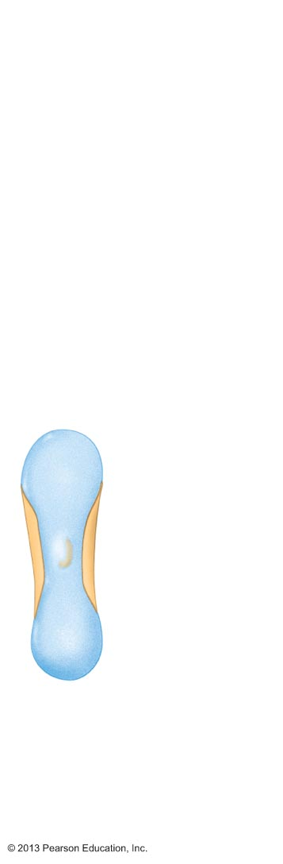
Figure 6.8 Endochondral ossification in a long bone.
Slide 2
Week 9
Hyaline
cartilage
Bone collar
Primary
ossification
center
Bone collar forms around the
diaphysis of the hyaline cartilage
model.
1
© 2013 Pearson Education, Inc.

Slide 8
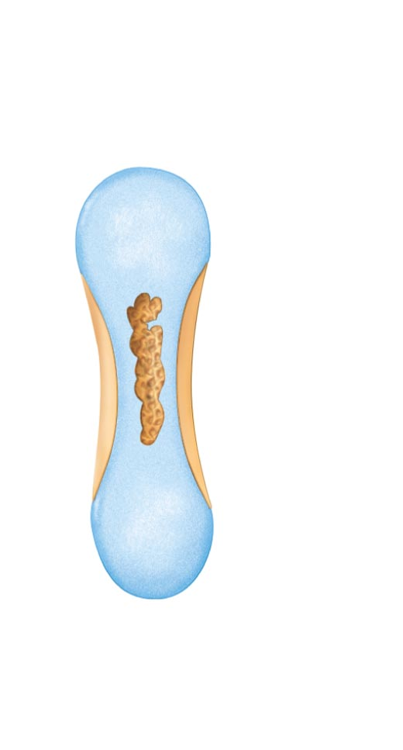
Figure 6.8 Endochondral ossification in a long bone.
Slide 3
Area of deteriorating
cartilage matrix
Cartilage in the center
of the diaphysis calcifies
and then develops cavities.
2
© 2013 Pearson Education, Inc.

Slide 9
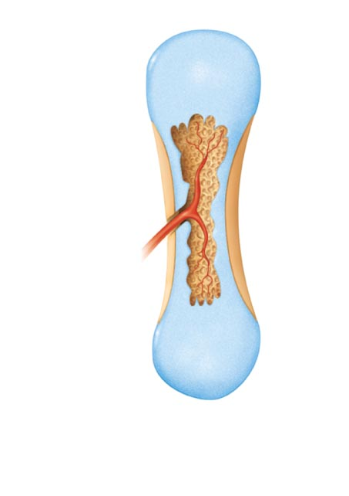
Figure 6.8 Endochondral ossification in a long bone.
Slide 4
Month 3
Spongy
bone
formation
Blood
vessel of
periosteal
bud
The periosteal bud invades
the internal cavities and spongy bone forms.
3
© 2013 Pearson Education, Inc.

Slide 10
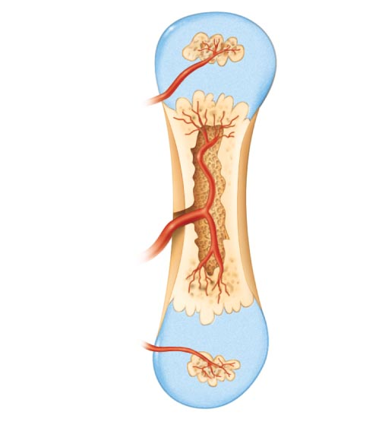
Figure 6.8 Endochondral ossification in a long bone.
Slide 5
Birth
Epiphyseal
blood vessel
Secondary
ossification
center
Medullary
cavity
4
The diaphysis elongates and a medullary cavity forms. Secondary ossification centers appear in the epiphyses.
© 2013 Pearson Education, Inc.

Slide 11
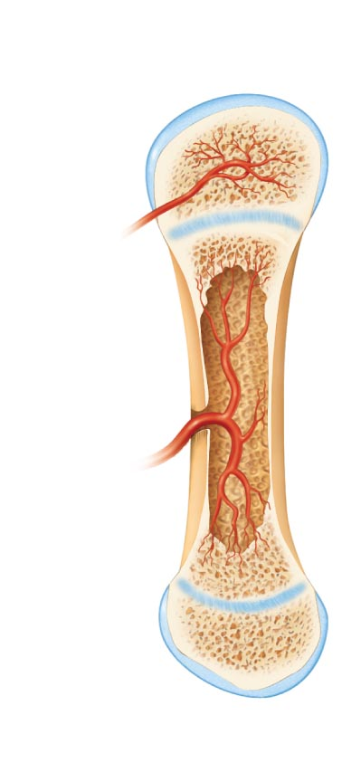
Figure 6.8 Endochondral ossification in a long bone.
Slide 6
Childhood to
adolescence
Articular
cartilage
Spongy
bone
Epiphyseal
plate
cartilage
The epiphyses ossify. When completed, hyaline cartilage remains only in the epiphyseal plates and articular cartilages.
5
© 2013 Pearson Education, Inc.

Slide 12
Figure 6.8 Endochondral ossification in a long bone.
Slide 7
Week 9
Month 3
Birth
Childhood to
adolescence
Articular
cartilage
Secondary
ossification
center
Spongy
bone
Area of
deteriorating
cartilage matrix
Epiphyseal
blood vessel
Epiphyseal
plate
cartilage
Hyaline
cartilage
Spongy
bone
formation
Medullary
cavity
Bone collar
Blood
vessel of
periosteal
bud
Primary
ossification
center
1
2
3
4
5
Bone collar
forms around the
diaphysis of the
hyaline cartilage
model.
Cartilage in the
center of the
diaphysis calcifies
and then develops
cavities.
The periosteal
bud invades the
internal cavities
and spongy bone
forms.
The diaphysis
elongates and a
medullary cavity
forms. Secondary
ossification
centers appear in
the epiphyses.
The epiphyses
ossify. When
completed, hyaline
cartilage remains
only in the
epiphyseal plates
and articular
cartilages.
© 2013 Pearson Education, Inc.

Slide 13
Intramembranous Ossification
Forms frontal, parietal, occipital, temporal bones, and clavicles
Begins within fibrous connective tissue membranes formed by mesenchymal cells
Ossification centers appear
Osteoid is secreted
Woven bone and periosteum form
Lamellar bone replaces woven bone & red marrow appears
© 2013 Pearson Education, Inc.

Slide 14
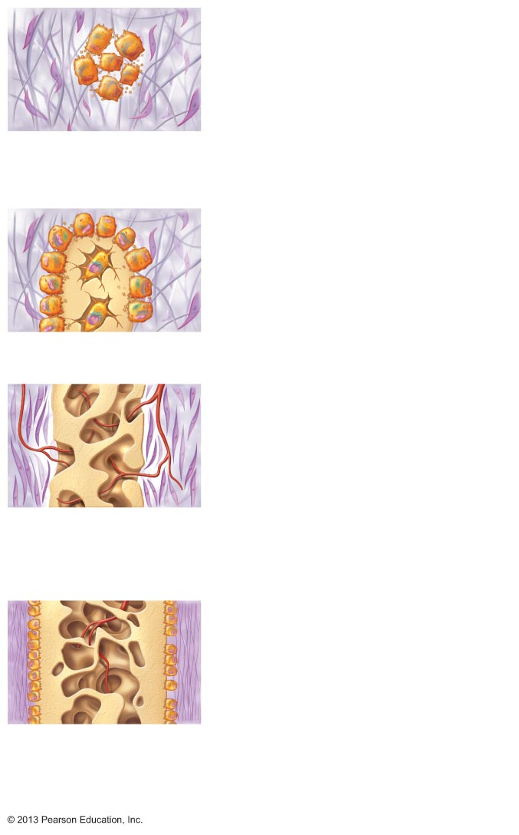
Figure 6.9 Intramembranous ossification.
Slide 1
Mesenchymal
cell
Osteoblast
Collagen fibril
Osteoid
Ossification
center
Osteocyte
Newly
calcified
bone matrix
Osteoid
Osteoblast
1 Ossification centers appear in the fibrous
connective tissue membrane.
• Selected centrally located mesenchymal cells
cluster and differentiate into osteoblasts, forming an
ossification center that produces the first trabeculae of
spongy bone.
2 Osteoid is secreted within the fibrous membrane and
calcifies.
• Osteoblasts begin to secrete osteoid, which calcifies in a few days.
• Trapped osteoblasts become osteocytes.
Mesenchyme
condensing
to form the
periosteum
Fibrous
periosteum
Osteoblast
Plate of
compact bone
Trabeculae of
woven bone
Diploë
(spongy bone)
cavities
contain red
marrow
Blood vessel
3 Woven bone and periosteum form.
• Accumulating osteoid is laid down between embryonic blood vessels in
a manner that results in a network (instead of concentric lamellae) of
trabeculae called woven bone.
• Vascularized mesenchyme condenses on the external face of the woven
bone and becomes the periosteum.
4 Lamellar bone replaces woven bone, just deep to the
periosteum. Red marrow appears.
• Trabeculae just deep to the periosteum thicken. Mature lamellar
bone replaces them, forming compact bone plates.
• Spongy bone (diploë), consisting of distinct trabeculae, persists
internally and its vascular tissue becomes red marrow.
© 2013 Pearson Education, Inc.

Slide 15
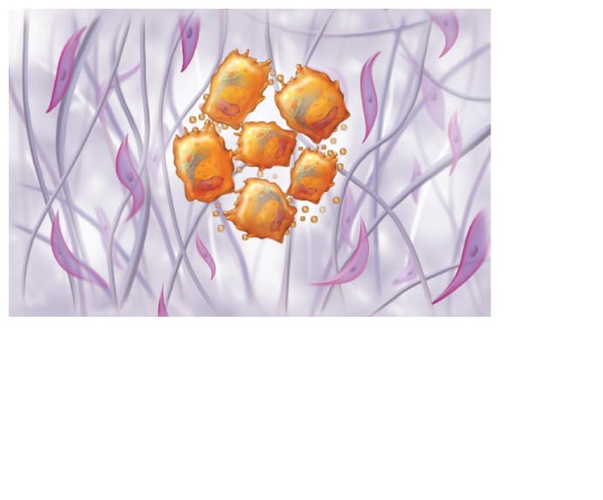
Figure 6.9 Intramembranous ossification.
Slide 2
Mesenchymal cell
Collagen fibril
Ossification center
Osteoid
Osteoblast
1 Ossification centers appear in the fibrous connective
tissue membrane.
• Selected centrally located mesenchymal cells cluster and
differentiate into osteoblasts, forming an ossification center
that produces the first trabeculae of spongy bone.
© 2013 Pearson Education, Inc.

Slide 16
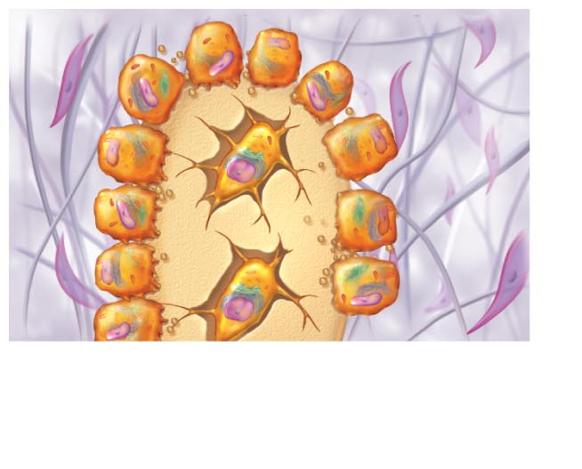
Figure 6.9 Intramembranous ossification.
Slide 3
Osteoblast
Osteoid
Osteocyte
Newly calcified
bone matrix
2 Osteoid is secreted within the fibrous membrane and
calcifies.
• Osteoblasts begin to secrete osteoid, which calcifies in a few days.
• Trapped osteoblasts become osteocytes.
© 2013 Pearson Education, Inc.

Slide 17
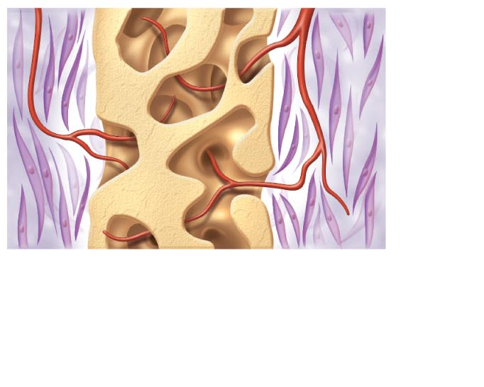
Figure 6.9 Intramembranous ossification.
Slide 4
Mesenchyme
condensing
to form the
periosteum
Trabeculae of
woven bone
Blood vessel
3 Woven bone and periosteum form.
• Accumulating osteoid is laid down between embryonic blood
vessels in a manner that results in a network (instead of
concentric lamellae) of trabeculae called woven bone.
• Vascularized mesenchyme condenses on the external face of
the woven bone and becomes the periosteum.
© 2013 Pearson Education, Inc.

Slide 18
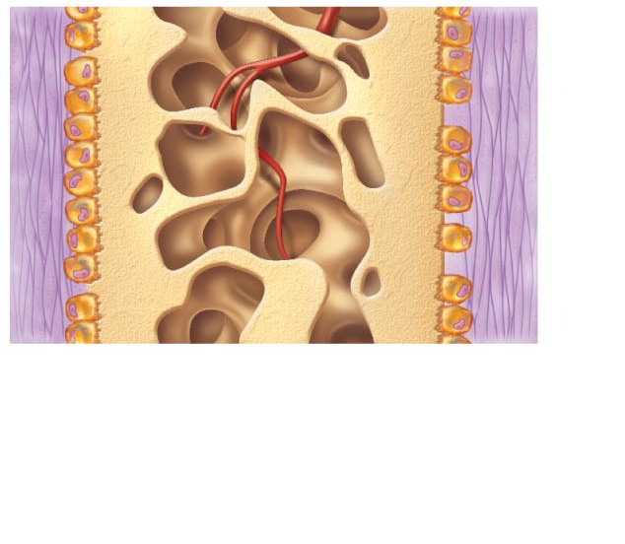
Figure 6.9 Intramembranous ossification.
Slide 5
Fibrous periosteum
Osteoblast
Plate of
compact bone
Diploë (spongy bone)
cavities contain red
marrow
4 Lamellar bone replaces woven bone, just deep to the
periosteum. Red marrow appears.
• Trabeculae just deep to the periosteum thicken. Mature
lamellar bone replaces them, forming compact bone plates.
• Spongy bone (diploë), consisting of distinct trabeculae,
persists internally and its vascular tissue becomes red marrow.
© 2013 Pearson Education, Inc.

Slide 19
Figure 6.9 Intramembranous ossification.
Slide 6
Mesenchymal
cell
Osteoblast
Collagen fibril
Osteoid
Ossification
center
Osteocyte
Newly
calcified
bone matrix
Osteoid
Osteoblast
1 Ossification centers appear in the fibrous
connective tissue membrane.
• Selected centrally located mesenchymal cells
cluster and differentiate into osteoblasts, forming an
ossification center that produces the first trabeculae of
spongy bone.
2 Osteoid is secreted within the fibrous membrane and
calcifies.
• Osteoblasts begin to secrete osteoid, which calcifies in a few days.
• Trapped osteoblasts become osteocytes.
Mesenchyme
condensing
to form the
periosteum
Fibrous
periosteum
Osteoblast
Plate of
compact bone
Trabeculae of
woven bone
Diploë
(spongy bone)
cavities
contain red
marrow
Blood vessel
3 Woven bone and periosteum form.
• Accumulating osteoid is laid down between embryonic blood vessels in
a manner that results in a network (instead of concentric lamellae) of
trabeculae called woven bone.
• Vascularized mesenchyme condenses on the external face of the woven
bone and becomes the periosteum.
4 Lamellar bone replaces woven bone, just deep to the
periosteum. Red marrow appears.
• Trabeculae just deep to the periosteum thicken. Mature lamellar
bone replaces them, forming compact bone plates.
• Spongy bone (diploë), consisting of distinct trabeculae, persists
internally and its vascular tissue becomes red marrow.
© 2013 Pearson Education, Inc.

Slide 20
Postnatal Bone Growth
Interstitial (longitudinal) growth
  Increase in length of long bones
Appositional growth
  Increase in bone thickness
© 2013 Pearson Education, Inc.

Slide 21
Interstitial Growth:
Growth in Length of Long Bones
Requires presence of epiphyseal cartilage
Epiphyseal plate maintains constant thickness
  Rate of cartilage growth on one side balanced by bone replacement on other
Concurrent remodeling of epiphyseal ends to maintain proportion
Result of five zones within cartilage
  Resting (quiescent) zone
  Proliferation (growth) zone
  Hypertrophic zone
  Calcification zone
  Ossification (osteogenic) zone
© 2013 Pearson Education, Inc.

Slide 22
Interstitial Growth:
Growth in Length of Long Bones
Resting (quiescent) zone
  Cartilage on epiphyseal side of epiphyseal plate
  Relatively inactive
Proliferation (growth) zone
  Cartilage on diaphysis side of epiphyseal plate
  Rapidly divide pushing epiphysis away from diaphysis → lengthening
Hypertrophic zone
  Older chondrocytes closer to diaphysis and their lacunae enlarge and erode → interconnecting spaces
© 2013 Pearson Education, Inc.

Slide 23
Interstitial Growth:
Growth in Length of Long Bones
Calcification zone
  Surrounding cartilage matrix calcifies, chondrocytes die and deteriorate
Ossification zone
  Chondrocyte deterioration leaves long spicules of calcified cartilage at epiphysis-diaphysis junction
  Spicules eroded by osteoclasts
  Covered with new bone by osteoblasts
  Ultimately replaced with spongy bone
© 2013 Pearson Education, Inc.

Slide 24
Interstitial Growth:
Growth in Length of Long Bones
Near end of adolescence chondroblasts divide less often
Epiphyseal plate thins then is replaced by bone
Epiphyseal plate closure
  Bone lengthening ceases
    Requires presence of cartilage
  Bone of epiphysis and diaphysis fuses
  Females – about 18 years
  Males – about 21 years
© 2013 Pearson Education, Inc.

Slide 25
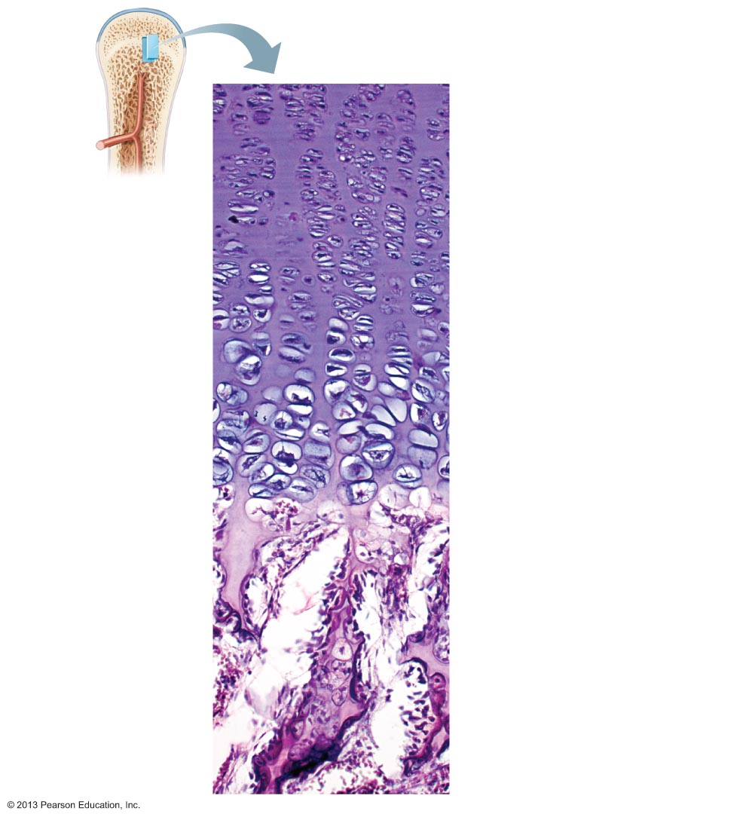
Figure 6.10 Growth in length of a long bone occurs at the epiphyseal plate.
Resting zone
1 Proliferation zone
Cartilage cells undergo
mitosis.
2 Hypertrophic zone
Older cartilage cells
enlarge.
3 Calcification zone
Matrix calcifies; cartilage
cells die; matrix begins
deteriorating; blood
vessels invade
cavity.
Calcified
cartilage spicule
Osteoblast
depositing bone
matrix
Osseous tissue
(bone) covering
cartilage spicules
4 Ossification zone
New bone forms.
© 2013 Pearson Education, Inc.

Slide 26
Appositional Growth: Growth in Width
Allows lengthening bone to widen
Occurs throughout life
Osteoblasts beneath periosteum secrete bone matrix on external bone
Osteoclasts remove bone on endosteal surface
Usually more building up than breaking down
  → Thicker, stronger bone but not too heavy
© 2013 Pearson Education, Inc.

Slide 27
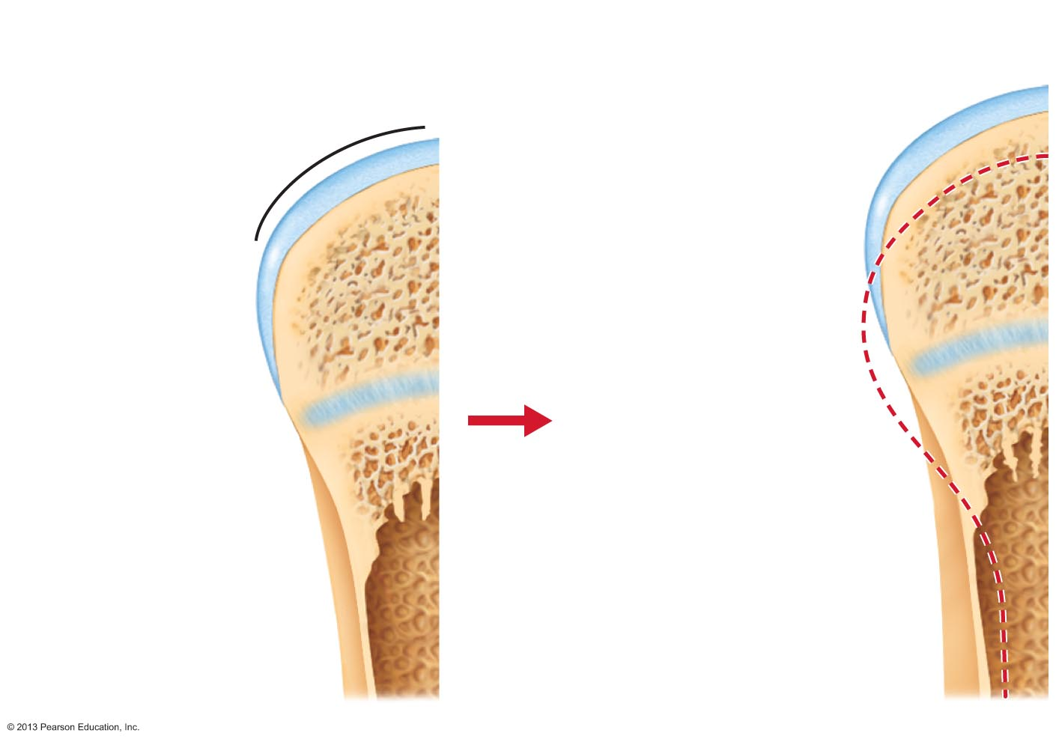
Figure 6.11 Long bone growth and remodeling during youth.
Bone growth
Bone remodeling
Articular cartilage
Cartilage
grows here.
Bone
replaces
cartilage
here.
Epiphyseal plate
Bone that was
here has been
resorbed.
Cartilage
grows here.
Appositional
growth adds
bone here.
Bone replaces
cartilage here.
Bone that was
here has been
resorbed.
© 2013 Pearson Education, Inc.

Slide 28
Hormonal Regulation of Bone Growth
Growth hormone
  Most important in stimulating epiphyseal plate activity in infancy and childhood
Thyroid hormone
  Modulates activity of growth hormone
  Ensures proper proportions
Testosterone (males) and estrogens (females) at puberty
  Promote adolescent growth spurts
  End growth by inducing epiphyseal plate closure
Excesses or deficits of any cause abnormal skeletal growth
© 2013 Pearson Education, Inc.

Slide 29
Bone Homeostasis
Recycle 5-7% of bone mass each week
  Spongy bone replaced ~ every 3-4 years
  Compact bone replaced ~ every 10 years
Older bone becomes more brittle
  Calcium salts Fractures more easily
Consists of bone remodeling and bone repair
© 2013 Pearson Education, Inc.

Slide 30
Bone Homeostasis: Bone Remodeling
Consists of both bone deposit and bone resorption
Occurs at surfaces of both periosteum and endosteum
Remodeling units
  Adjacent osteoblasts and osteoclasts
© 2013 Pearson Education, Inc.

Slide 31
Bone Deposit
Evidence of new matrix deposit by osteoblasts
  Osteoid seam
    Unmineralized band of bone matrix
  Calcification front
    Abrupt transition zone between osteoid seam and older mineralized bone
Trigger not confirmed
  Mechanical signals involved
  Endosteal cavity concentrations of calcium and phosphate ions for hydroxyapatite formation
  Matrix proteins bind and concentrate calcium
  Enzyme alkaline phosphatase for mineralization
© 2013 Pearson Education, Inc.

Slide 32
Bone Resorption
Is function of osteoclasts
  Dig depressions or grooves as break down matrix
  Secrete lysosomal enzymes that digest matrix and protons (H⁺)
  Acidity converts calcium salts to soluble forms
Osteoclasts also
  Phagocytize demineralized matrix and dead osteocytes
    Transcytosis allow release into interstitial fluid and then into blood
  Once resorption complete, osteoclasts undergo apoptosis
Osteoclast activation involves PTH and T cell-secreted proteins
© 2013 Pearson Education, Inc.

Slide 33
Control of Remodeling
Occurs continuously but regulated by genetic factors and two control loops
  Negative feedback hormonal loop for Ca²⁺ homeostasis
    Controls blood Ca²⁺ levels; Not bone integrity
  Responses to mechanical and gravitational forces
© 2013 Pearson Education, Inc.

Slide 34
Importance of Calcium
Functions in
  Nerve impulse transmission
  Muscle contraction
  Blood coagulation凝结
  Secretion by glands and nerve cells
  Cell division
1200 – 1400 grams of calcium in body
  99% as bone minerals
  Amount in blood tightly regulated (9-11 mg/dl)
  Intestinal 肠的 absorption requires Vitamin D metabolites
  Dietary intake required
© 2013 Pearson Education, Inc.

Slide 35
Hormonal Control of Blood Ca²⁺
Parathyroid 副甲状腺的 hormone (PTH)
  Produced by parathyroid glands
  Removes calcium from bone regardless of bone integrity完整
Calcitonin may be involved
  Produced by parafollicular cells of thyroid gland
  In high doses lowers blood calcium levels temporarily
© 2013 Pearson Education, Inc.

Slide 36
Negative Feedback Hormonal Loop for blood Ca²⁺ Homeostasis
Controlled by parathyroid hormone (PTH)
↓ Blood Ca²+ levels
↓
PTH release
↓
PTH stimulates osteoclasts to degrade bone matrix, releasing Ca²⁺
↓
Blood Ca²⁺ levels
↓
PTH release ends
© 2013 Pearson Education, Inc.

Slide 37
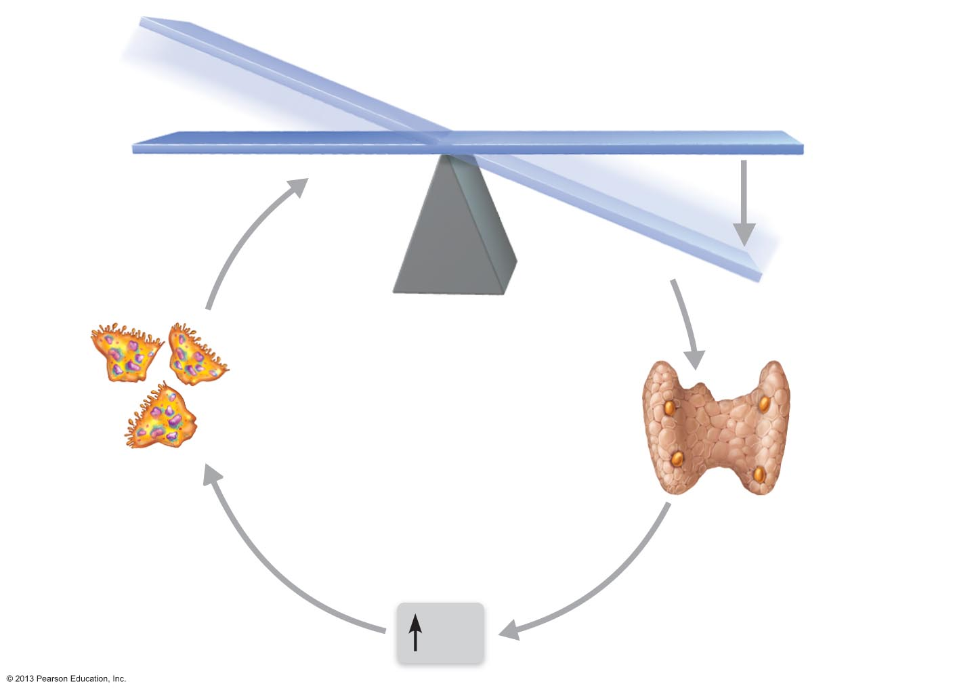
Figure 6.12 Parathyroid hormone (PTH) control of blood calcium levels.
IMBALANCE
Calcium homeostasis of blood: 9–11 mg/100 ml
BALANCE
BALANCE
Stimulus
Falling blood
Ca²⁺ levels
IMBALANCE
Thyroid
gland
Osteoclasts
degrade bone
matrix and release
Ca²⁺ into blood.
Parathyroid
glands
Parathyroid
glands release
parathyroid
hormone (PTH).
PTH
© 2013 Pearson Education, Inc.

Slide 38
Calcium Homeostasis
Even minute changes in blood calcium dangerous
  Severe neuromuscular 神经肌肉的 problems
    Hyperexcitability (levels too low)
    Nonresponsiveness (levels too high)
  Hypercalcemia
    Sustained high blood calcium levels
    Deposits of calcium salts in blood vessels, kidneys can interfere with function
© 2013 Pearson Education, Inc.

Slide 39
Other Hormones Affecting Bone Density
Leptin【生化】瘦素
  Hormone released by adipose tissue
  Role in bone density regulation
    Inhibits osteoblasts in animals
Serotonin血清素
  Neurotransmitter regulating mood and sleep
  Most made in gut
  Secreted into blood after eating
    Interferes with osteoblast activity
    Serotonin reuptake inhibitors (e.g., Prozac) cause lower bone density
© 2013 Pearson Education, Inc.

Slide 40
Bone Homeostasis: Response to Mechanical Stress
Bones reflect stresses they encounter
  Long bones thickest midway along diaphysis where bending stresses greatest
Bones stressed when weight bears on them or muscles pull on them
  Usually off center so tends to bend bones
  Bending compresses on one side; stretches on other
© 2013 Pearson Education, Inc.

Slide 41
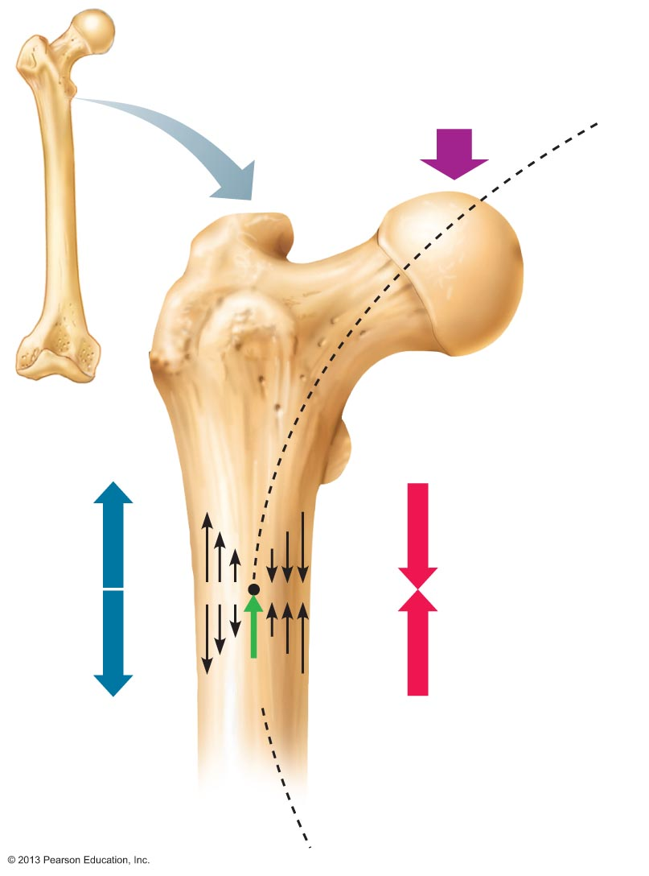
Figure 6.13 Bone anatomy and bending stress.
Load here
(body weight)
Head of
femur
Tension
here
Compression
here
Point of
no stress
© 2013 Pearson Education, Inc.

Slide 42
Results of Mechanical Stressors:
Wolff's Law
Bones grow or remodel in response to demands placed on it
Explains
  Handedness (right or left handed) results in thicker and stronger bone of that upper limb
  Curved bones thickest where most likely to buckle弯曲
  Trabeculae form trusses along lines of stress
  Large, bony projections occur where heavy, active muscles attach
  Bones of fetus and bedridden featureless
© 2013 Pearson Education, Inc.

Slide 43
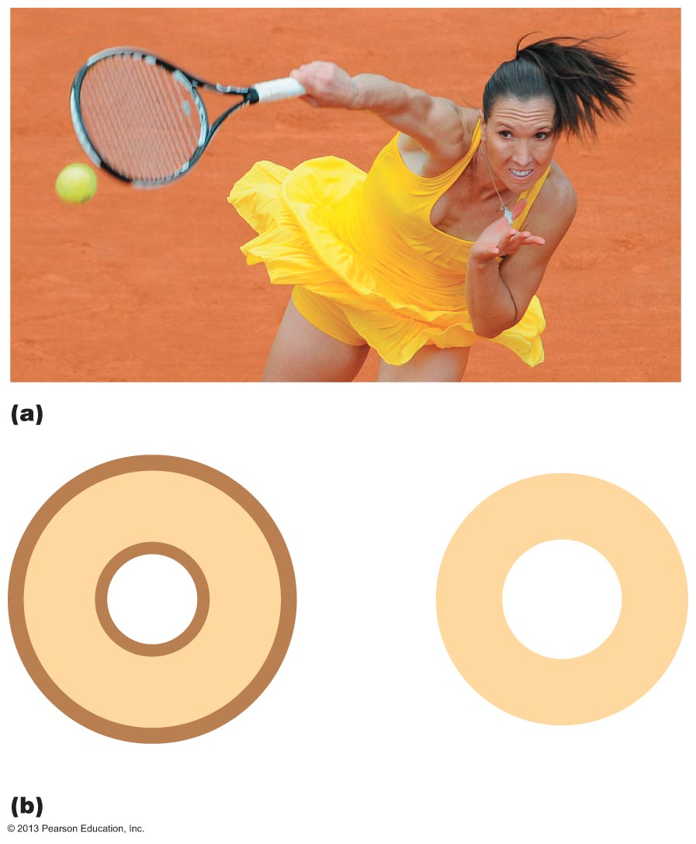
Figure 6.14 Vigorous exercise can strengthen bone.
Cross-
sectional
dimension
of the
humerus
Added
bone matrix
counteracts
added stress
Serving arm
Nonserving arm
© 2013 Pearson Education, Inc.

Slide 44
How Mechanical Stress Causes Remodeling
Electrical signals produced by deforming bone may cause remodeling
  Compressed and stretched regions oppositely charged
Fluid flows within canaliculi appear to provide remodeling stimulus
© 2013 Pearson Education, Inc.

Slide 45
Results of Hormonal and Mechanical Influences
Hormonal controls determine whether and when remodeling occurs to changing blood calcium levels
Mechanical stress determines where remodeling occurs
© 2013 Pearson Education, Inc.

Slide 46
Bone Repair
Fractures骨折
  Breaks
  Youth
    Most result from trauma
  Old age
    Most result of weakness from bone thinning
© 2013 Pearson Education, Inc.

Slide 47
Fracture Classification
Three "either/or" fracture classifications
  Position of bone ends after fracture
    Nondisplaced—ends retain normal position
    Displaced—ends out of normal alignment
  Completeness of break
    Complete—broken all the way through
    Incomplete—not broken all the way through
  Whether skin is penetrated
    Open (compound) - skin is penetrated
    Closed (simple) – skin is not penetrated
© 2013 Pearson Education, Inc.

Slide 48
Classification of Bone Fractures
Also described by location of fracture
External appearance
Nature of break
© 2013 Pearson Education, Inc.

Slide 49
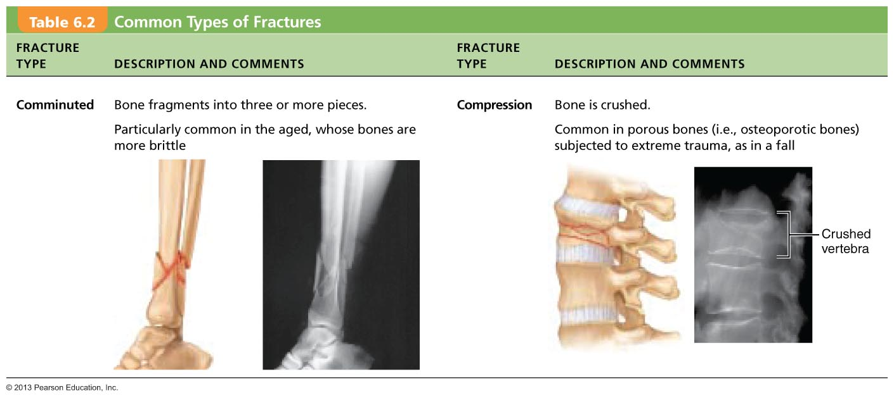
Table 6.2 Common Types of Fractures (1 of 3)
© 2013 Pearson Education, Inc.

Slide 50
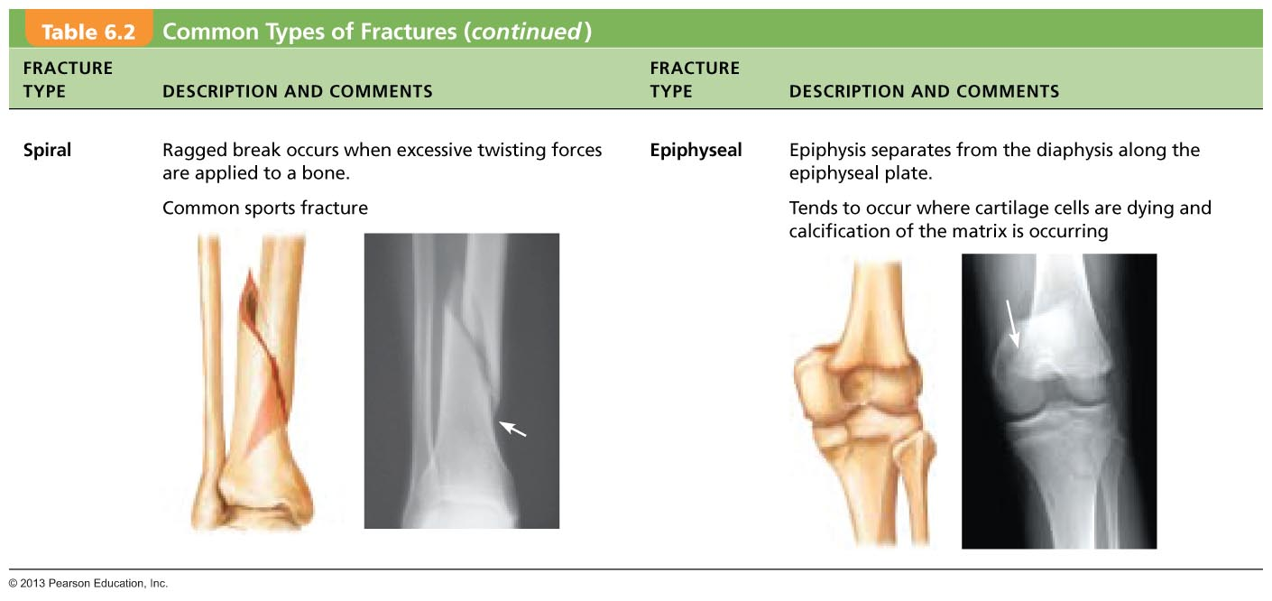
Table 6.2 Common Types of Fractures (2 of 3)
© 2013 Pearson Education, Inc.

Slide 51
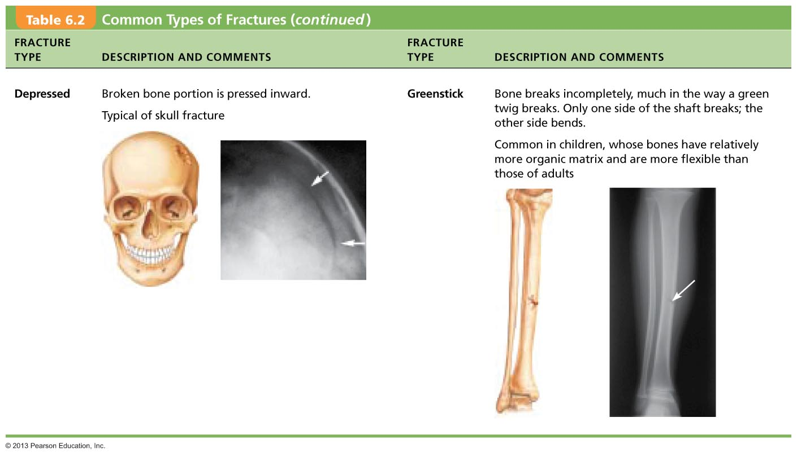
Table 6.2 Common Types of Fractures (3 of 3)
© 2013 Pearson Education, Inc.

Slide 52
Fracture Treatment and Repair
Treatment
  Reduction
    Realignment of broken bone ends
    Closed reduction – physician manipulates to correct position
    Open reduction – surgical pins or wires secure ends
  Immobilization by cast or traction for healing
    Depends on break severity, bone broken, and age of patient
© 2013 Pearson Education, Inc.

Slide 53
Stages of Bone Repair: HEMATOMA Forms
Torn blood vessels hemorrhage
Clot (hematoma) forms
Site swollen, painful, and inflamed
© 2013 Pearson Education, Inc.

Slide 54
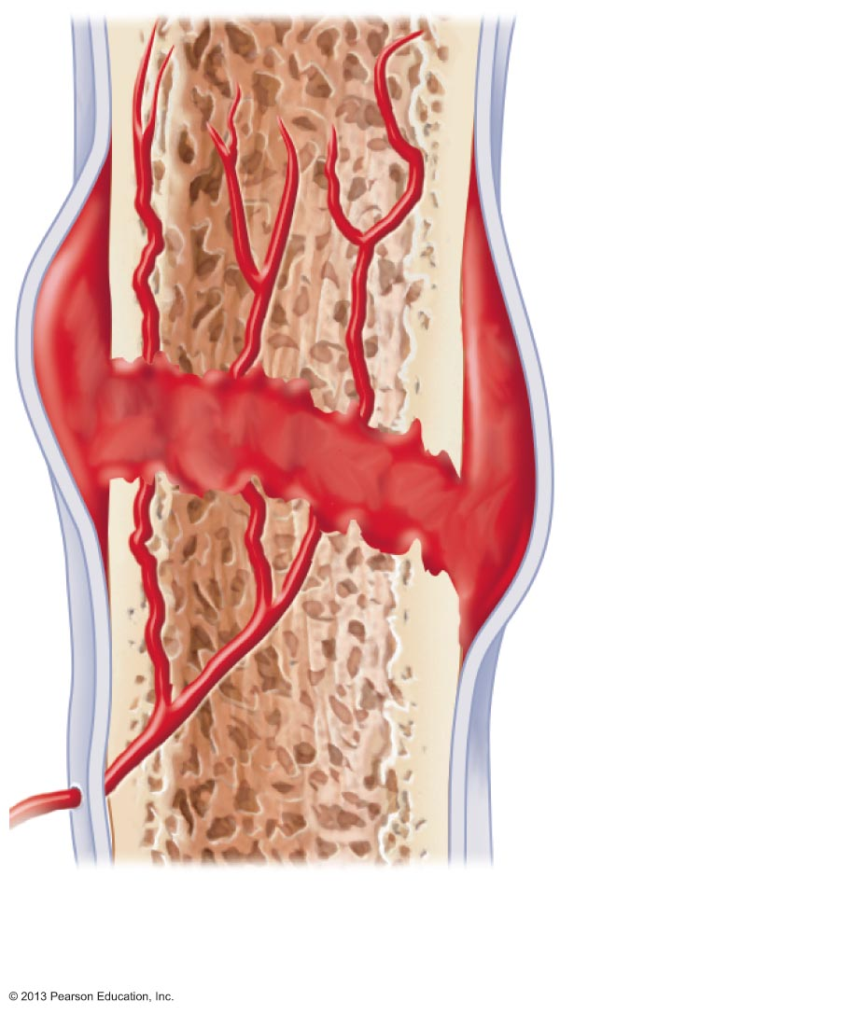
Figure 6.15 Stages in the healing of a bone fracture. (1 of 4)
Hematoma
1 A hematoma forms.
© 2013 Pearson Education, Inc.

Slide 55
Stages of Bone Repair:
Fibrocartilaginous Callus Forms
Capillaries 毛细管 grow into hematoma
Phagocytic 吞噬细胞的 cells clear debris
Fibroblasts secrete collagen fibers to span break and connect broken ends
Fibroblasts, cartilage, and osteogenic cells begin reconstruction of bone
  Create cartilage matrix of repair tissue
  Osteoblasts form spongy bone within matrix
Mass of repair tissue called fibrocartilaginous callus
© 2013 Pearson Education, Inc.

Slide 56
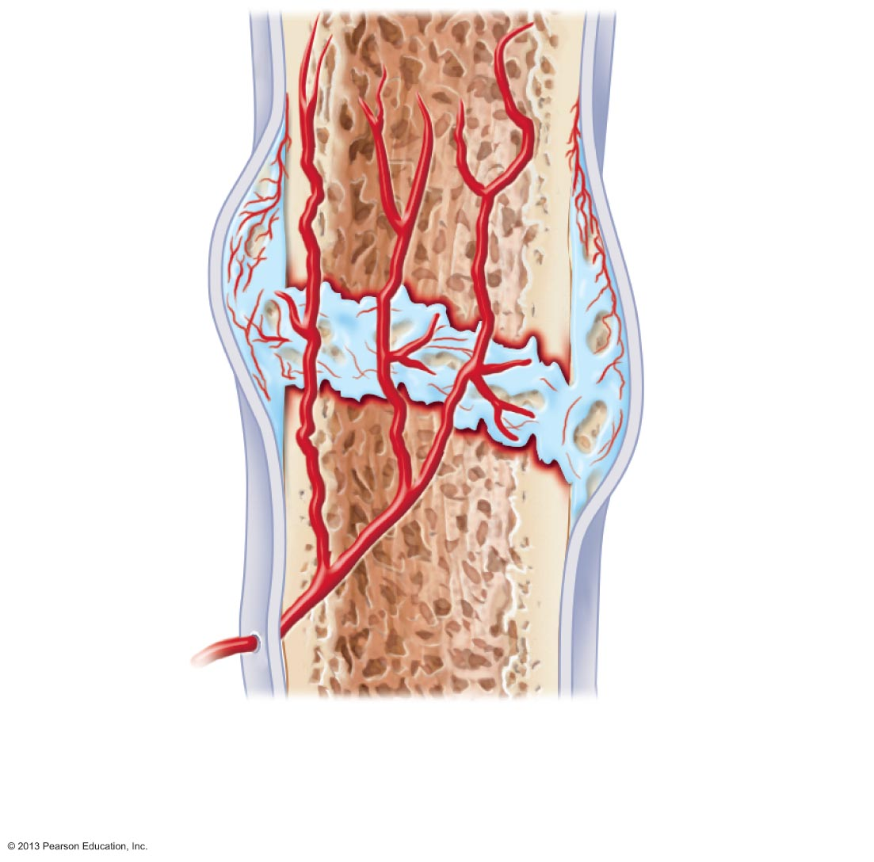
Figure 6.15 Stages in the healing of a bone fracture. (2 of 4)
External
callus
New
blood
vessels
Internal
callus
(fibrous
tissue and
cartilage)
Spongy
bone
trabecula
2 Fibrocartilaginous
callus forms.
© 2013 Pearson Education, Inc.

Slide 57
Stages of Bone Repair:
Bony Callus Forms
Within one week new trabeculae appear in fibrocartilaginous callus
Callus converted to bony (hard) callus of spongy bone
~2 months later firm union forms
© 2013 Pearson Education, Inc.

Slide 58
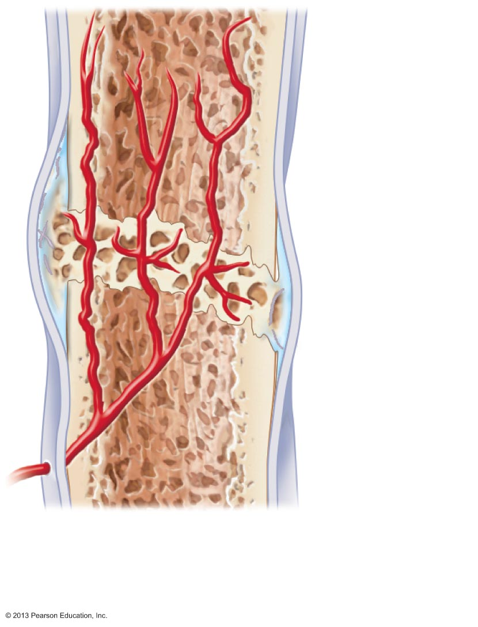
Figure 6.15 Stages in the healing of a bone fracture. (3 of 4)
Bony
callus of
spongy
bone
3 Bony callus
forms.
© 2013 Pearson Education, Inc.

Slide 59
Stages of Bone Repair:
Bone Remodeling Occurs
Begins during body callus formation
Continues for several months
Excess material on diaphysis exterior and within medullary cavity removed
Compact bone laid down to reconstruct shaft walls
Final structure resembles original because responds to same mechanical stressors
© 2013 Pearson Education, Inc.

Slide 60
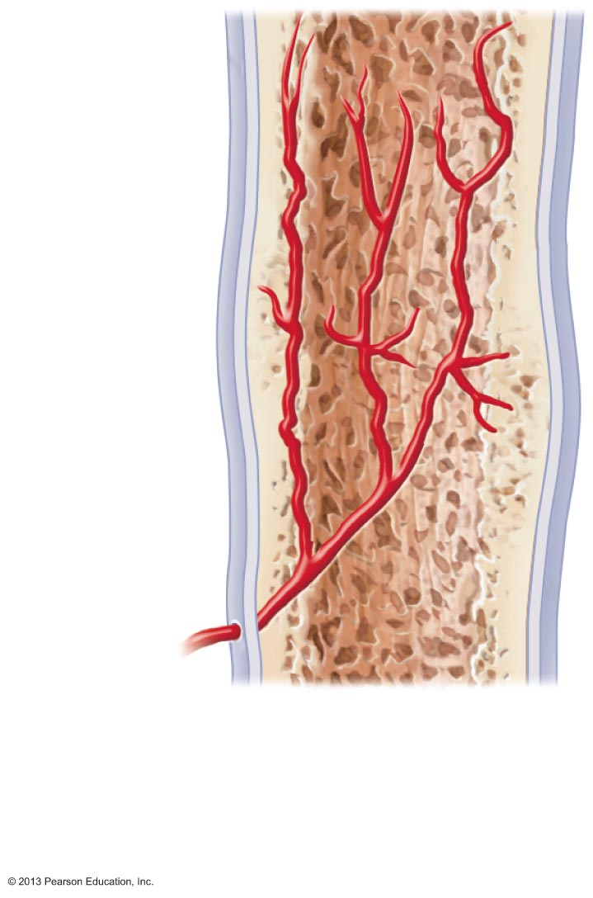
Figure 6.15 Stages in the healing of a bone fracture. (4 of 4)
Healed
fracture
4 Bone
remodeling
occurs.
© 2013 Pearson Education, Inc.

Slide 61
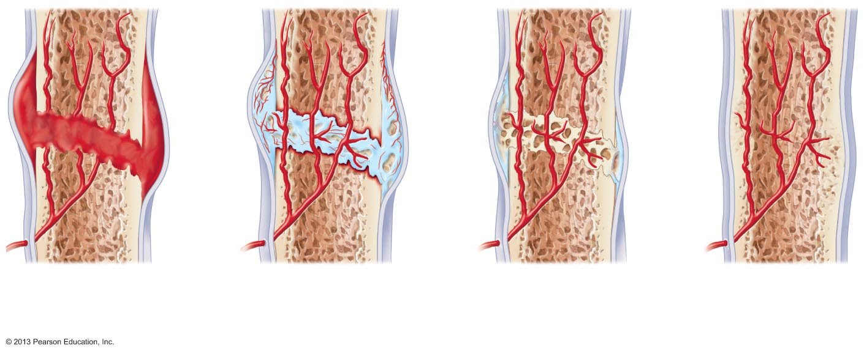
Figure 6.15 Stages in the healing of a bone fracture.
Hematoma
External
callus
Bony
callus of
spongy
bone
New
blood
vessels
Internal
callus
(fibrous
tissue and
cartilage)
Healed
fracture
Spongy
bone
trabecula
1 A hematoma forms.
2 Fibrocartilaginous
callus forms.
3 Bony callus
forms.
4 Bone
remodeling
occurs.
© 2013 Pearson Education, Inc.

Slide 62
Homeostatic Imbalances
Osteomalacia软骨病
  Bones poorly mineralized
  Calcium salts not adequate
  Soft, weak bones
  Pain upon bearing weight
Rickets 佝偻病 (osteomalacia of children)
  Bowed legs and other bone deformities
  Bones ends enlarged and abnormally long
  Cause: Vitamin D deficiency or insufficient dietary calcium
© 2013 Pearson Education, Inc.

Slide 63
Homeostatic Imbalances
Osteoporosis骨质疏松症
  Group of diseases
  Bone resorption outpaces deposit
  Spongy bone of spine and neck of femur most susceptible
    Vertebral and hip fractures common
© 2013 Pearson Education, Inc.

Slide 64
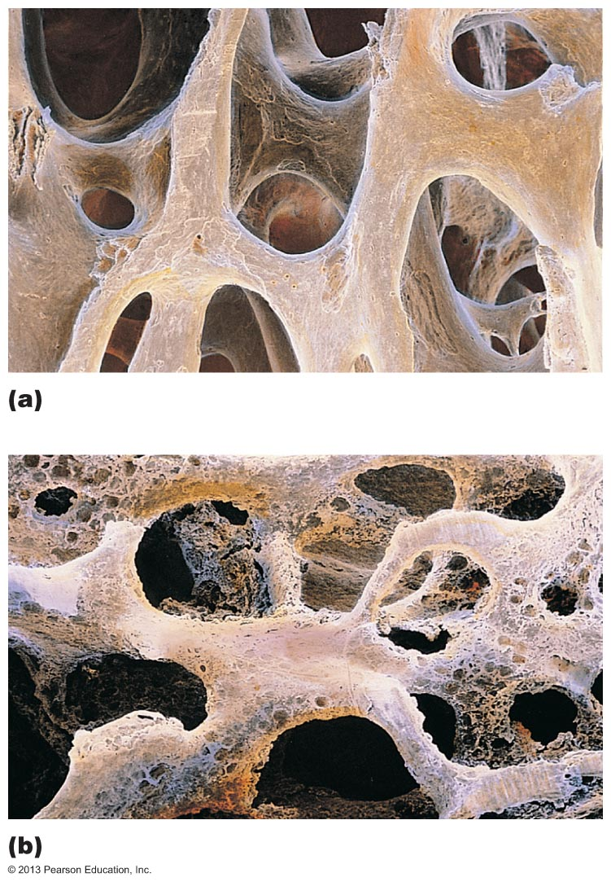
Figure 6.16 The contrasting architecture of normal versus osteoporotic bone.
Normal bone
Osteoporotic bone
© 2013 Pearson Education, Inc.

Slide 65
Risk Factors for Osteoporosis
Risk factors
  Most often aged, postmenopausal women
    30% 60 – 70 years of age; 70% by age 80
    30% Caucasian women will fracture bone because of it
  Men to lesser degree
  Sex hormones maintain normal bone health and density
    As secretion wanes with age osteoporosis can develop
© 2013 Pearson Education, Inc.

Slide 66
Additional Risk Factors for Osteoporosis
Petite body form
Insufficient exercise to stress bones
Diet poor in calcium and protein
Smoking
Hormone-related conditions
  Hyperthyroidism
  Low blood levels of thyroid-stimulating hormone
  Diabetes mellitus
Immobility
Males with prostate cancer taking androgen-suppressing drugs
© 2013 Pearson Education, Inc.

Slide 67
Treating Osteoporosis
Traditional treatments
  Calcium
  Vitamin D supplements
  Weight-bearing exercise
  Hormone replacement therapy
    Slows bone loss but does not reverse it
    Controversial due to increased risk of heart attack, stroke, and breast cancer
    Some take estrogenic compounds in soy as substitute
© 2013 Pearson Education, Inc.

Slide 68
New Drugs for Osteoporosis Treatment
Bisphosphonates
  Decrease osteoclast activity and number
  Partially reverse in spine
Selective estrogen receptor modulators
  Mimic estrogen without targeting breast and uterus
Statins
  Though for lowering cholesterol also increase bone mineral density
Denosumab
  Monoclonal antibody
  Reduces fractures in men with prostate cancer
  Improves bone density in elderly
© 2013 Pearson Education, Inc.

Slide 69
Preventing Osteoporosis
Plenty of calcium in diet in early adulthood
Reduce carbonated beverage and alcohol consumption
  Leaches minerals from bone so decreases bone density
Plenty of weight-bearing exercise
  Increases bone mass above normal for buffer against age-related bone loss
© 2013 Pearson Education, Inc.

Slide 70
Paget's Disease
Excessive and haphazard bone deposit and resorption
  Bone made fast and poorly – called Pagetic bone
    Very high ratio of spongy to compact bone and reduced mineralization
  Usually in spine, pelvis, femur, and skull
Rarely occurs before age 40
Cause unknown - possibly viral
Treatment includes calcitonin and biphosphonates
© 2013 Pearson Education, Inc.

Slide 71
Developmental Aspects of Bones
Embryonic skeleton ossifies predictably so fetal age easily determined from X rays or sonograms
Most long bones begin ossifying by 8 weeks
Primary ossification centers by 12 weeks
At birth, most long bones well ossified (except epiphyses)
At age 25 ~ all bones completely ossified and skeletal growth ceases
© 2013 Pearson Education, Inc.

Slide 72
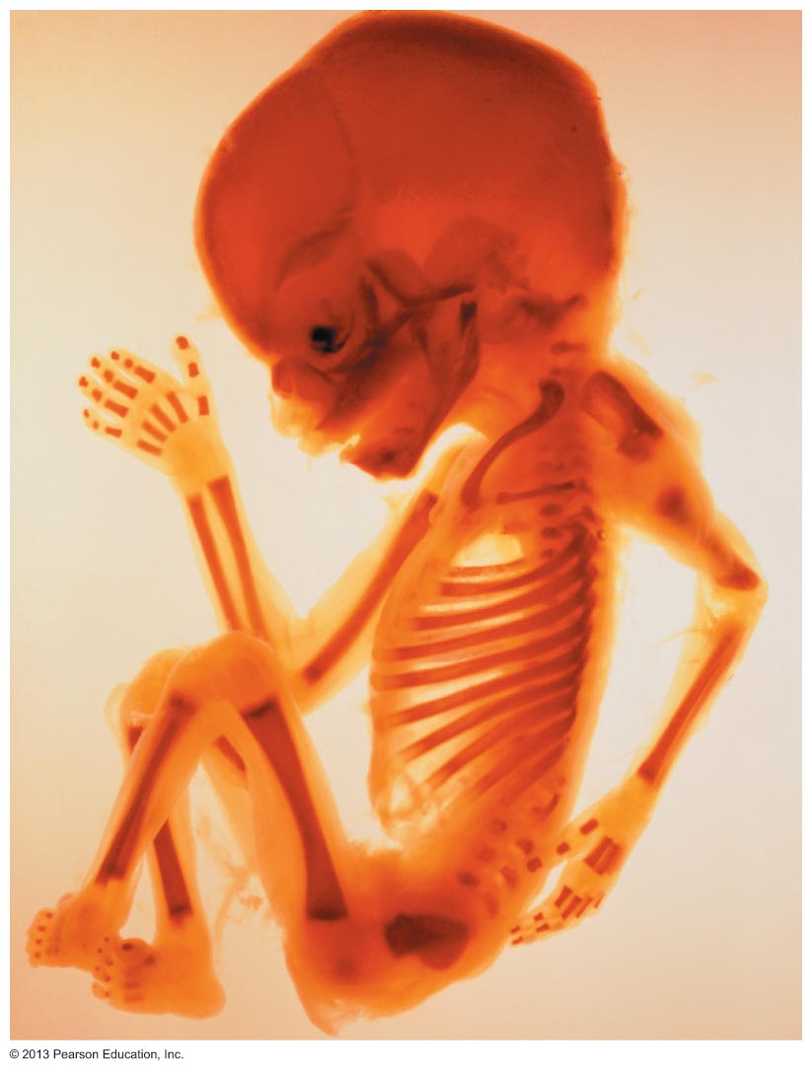
Figure 6.17 Fetal primary ossification centers at 12 weeks.
Parietal
bone
Frontal
bone
of skull
Occipital
bone
Mandible
Clavicle
Scapula
Radius
Ulna
Humerus
Femur
Tibia
Ribs
Vertebra
Ilium
© 2013 Pearson Education, Inc.

Slide 73
Age-related Changes in Bone
Children and adolescents
  Bone formation exceeds resorption
Young adults
  Both in balance; males greater mass
Bone density changes over lifetime largely determined by genetics
  Gene for Vitamin D's cellular docking determines mass early in life and osteoporosis risk as age
Bone mass, mineralization, and healing ability decrease with age beginning in 4th decade
  Except bones of skull
  Bone loss greater in whites and in females
  Electrical stimulation; Daily ultrasound treatments hasten repair
© 2013 Pearson Education, Inc.

